Slide 1
Health
Agenda week of 12-5-16
TOPIC: MENTAL HEALTH MYTH VS FACT
ATTENDANCE FIRST THEN…..
CHOOSE YOUR NEW SEAT, AND CHOOSE WISELY!!!
MAKE SURE WHO YOU SIT NEXT TO IS WHO YOU CAN AND WILL WORK WITH!!! DON’T BUNCH UP
Notes:
http://walkinourshoes.org/content/Classroom_Lesson_Plans.pdf

Slide 2
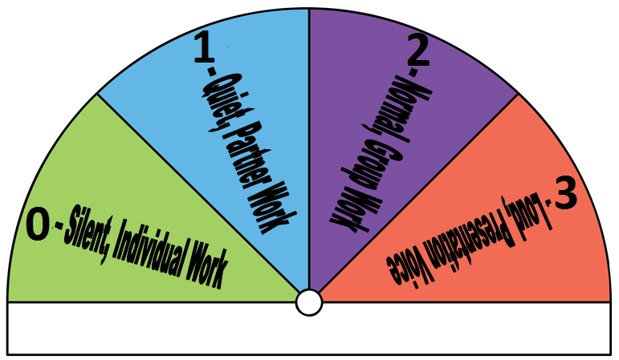
Bellringer 12-5-16
What is the difference between Myth and Fact?

Slide 3
Good News
Tell me something good!

Slide 4
Fact vs. Myth
What is the difference between the two?
Work with a new partner. Do not leave anyone out
Sort the statements under FACT/ MYTH
http://walkinourshoes.org/myths-vs-facts

Slide 5
REFLECT
What is the difference between myth and fact?
Why do you think it is important to know the myths and facts about mental illness?
How could it be hurtful for people to think that the myths of mental illness are facts?

Slide 6
Bellringer 12-6-16
Have you ever had a door slammed on you? In your face? Have you ever slammed a door? What does it feel like to have a door slammed in your face?

Slide 7
Good News
Tell me something good!

Slide 8
Slammin’
Create a list of things kids say to one another that slams the door in their face…. Class discussion….

Slide 9
Helpful Responses
How could we respond in helpful ways?

Slide 10
Slammer Scenarios
For each scenario or situation, write a helpful response….
We will share at the end, and you need to turn in ….

Slide 11
Wrap up
How was it coming up with something better than a slammer? Who found it difficult?
Who found it easy?

Slide 12
Bellringer 12-7-16
What are your plans for your half day?
Whatever you choose to do, I hope you enjoy

Slide 13
Heads Up
We will have our test over Mental health Next Thursday.
We will review on Wednesday and you will take the test on Thursday.

Slide 14
Good News
Tell me something good!

Slide 15
Skits….
What makes a skit good?
Review, plan and present….

Slide 16
Organize your notebook
Your Pages might be different…. That’s ok for now
Page 1- I Can Statements & Vocabulary
Page 2-Pretest
Page 3 Bellringers
Page 4 Bellringers cont….
Page 5 Scenarios-staple or tape this into your notebook
Page 6-Mental Health Challenges (you will complete this page next week)

Slide 17
Bellringer 12-8-16
We are going to do our social contract today…..
How do you want Ms. Dryer to treat you
How do you think Ms. Dryer wants to be treated by you
How are you going to treat each other
How are we going to handle conflict
These are the questions we use to build a social contract… Write down your top 5 words. Turn and share with your on-task partner, add your partner's words to your bell ringer….
We will use these words to build our social contract :-)

Slide 18
Good News
Tell me something good!

Slide 19
Return Papers
Organize papers into your notebook
Check Grades
Volume 1!!

Slide 20
Bellringer 12-9-16
In your shoes, what is it like to be in your shoes?
What 10 words would you use to best describe you?

Slide 21
Good News
Tell me something good!

Slide 22
Design your own shoe
Choose a shoe to color and decorate however you wish with the markers and coloring supplies.
Write your name, I am…. And write the positive words you or someone you know would use to describe you….
You will share in small groups…

