Slide 1
HEALTH
AGENDA WEEK OF 12-12-16

Slide 2
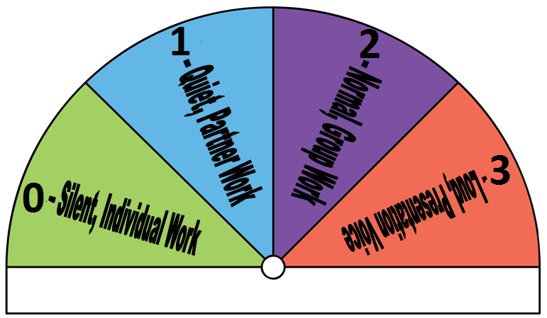
Bellringer 12-13-16
Describe your morning routine, from the time you get up until 1st hour.
Put a star next to things that are Social Health
Put a check next to things that are Physical Health
Put a square next to things that are Emotional Health
Put a circle next to things that are Mental Health
Which area of health does your morning routine fall mostly under?

Slide 3
Good News
Tell me something good!

Slide 4
In Your Shoes
Let’s share!
Someone start the connection train. When you hear a connection, come up and share your I Am….

Slide 5
Vocabulary
Emotional Health- The way you recognize and deal with your feelings.
EX: Express your feelings in words rather than acting them out, show self-control, and think before you act, accept your strengths and weaknesses, respect yourself,
Sentence:

Slide 6
Vocabulary
Physical Health- the condition of the body
EX: 8 hours of sleep, eat nutritious foods, plenty of physical activity, practice good hygiene, avoid drugs, alcohol, tobacco
Sentence:

Slide 7
Vocabulary
Social Health- How you get along with others, and interact with others
EX: being considerate, showing respect, dependable, supportive, express your true feelings, asking for help….
Sentence:

Slide 8
Lesson Review page 7
Answer each question completely in your notebook.

Slide 9
Launch
Zero behind your chairs. Launcher read a launch

Slide 10
Bellringer 12-14-16
Free write or draw….

Slide 11
Good News
Tell me something good!

Slide 12
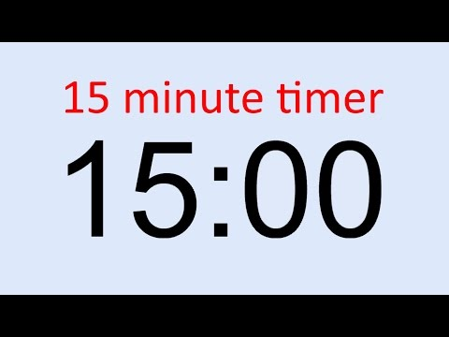
Lesson Review page 7
Answer each question completely in your notebook.
Tear out and turn in when done….

Slide 13
Test review

Slide 14
Launch
Zero behind your chairs. Launcher read a launch

Slide 15
Bellringer 12-15-16
Study your notes in your notebook

Slide 16
Test
Must remain at a zero until everyone is done
When you are finished, read your book or draw….

Slide 17
Silent interview
Write back and forth to each other….
We will fold the paper when finished….
Sssshhhhhhh zero!

Slide 18
Launch
Zero behind chairs…. 3. 2, 1….

